Slide 1

Usability Testing Suite With Facial Expression Recognition
Damian Wojtowicz
C17413722
DT228
Supervisor: Andrea Curley

Slide 2

SUMMARY OF CONTENTS
Main Topics
Project Aims
Background
Methodologies
System Architecture
Prototypes & Design
Development
Demo
Testing & Evaluation
Future Work
2

Slide 3

PROJECT AIMS
The aim of the project is to provide a usability testing suite that can be used to test the usability of software and to investigate the use and applicability of facial expression recognition (FER) technology in usability testing.
WHAT IS THE PROJECT ABOUT?
3

Slide 4
BACKGROUND
Landowska (2015) investigated the use of emotion analysis for usability testing.
Their research included various means of obtaining the emotion data, one of which was facial expression recognition.
EXISTING RESEARCH
4

Slide 5
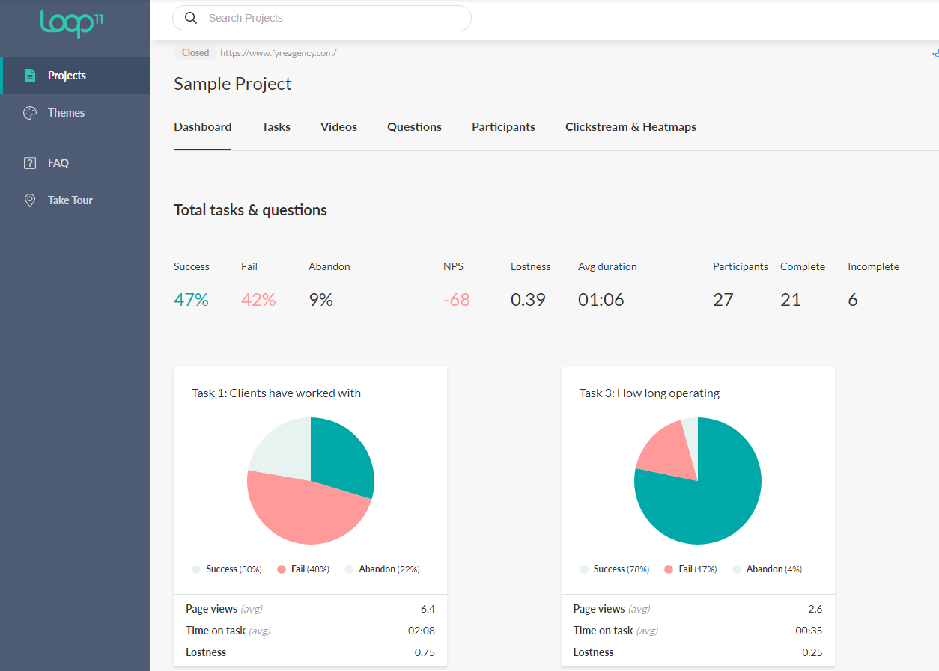
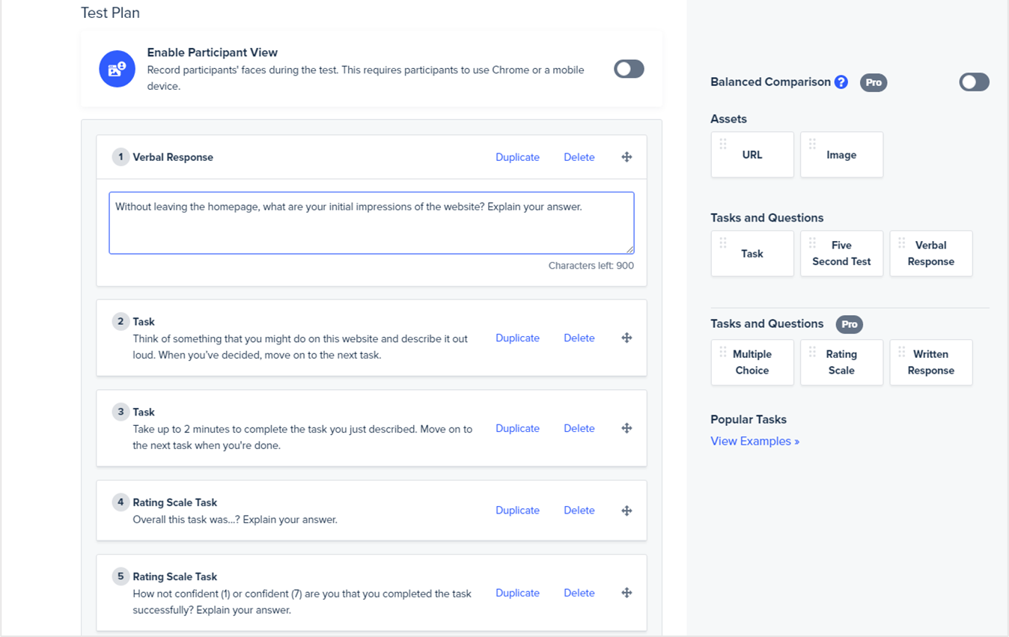
BACKGROUND
EXISTING APPLICATIONS
5

Slide 6
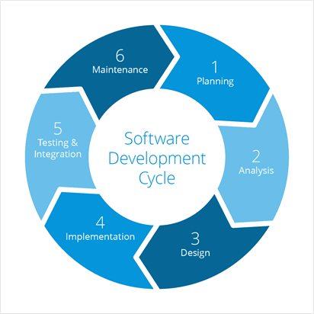
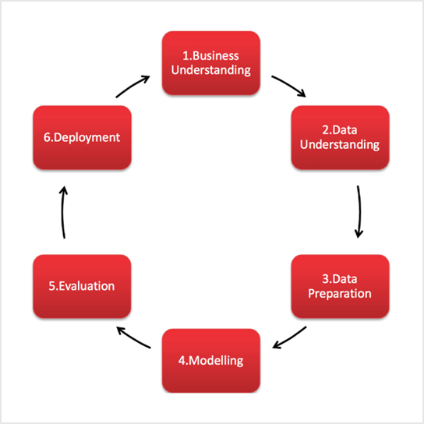
METHODOLOGIES
Scrum Agile
CRISP-DM
6

Slide 7
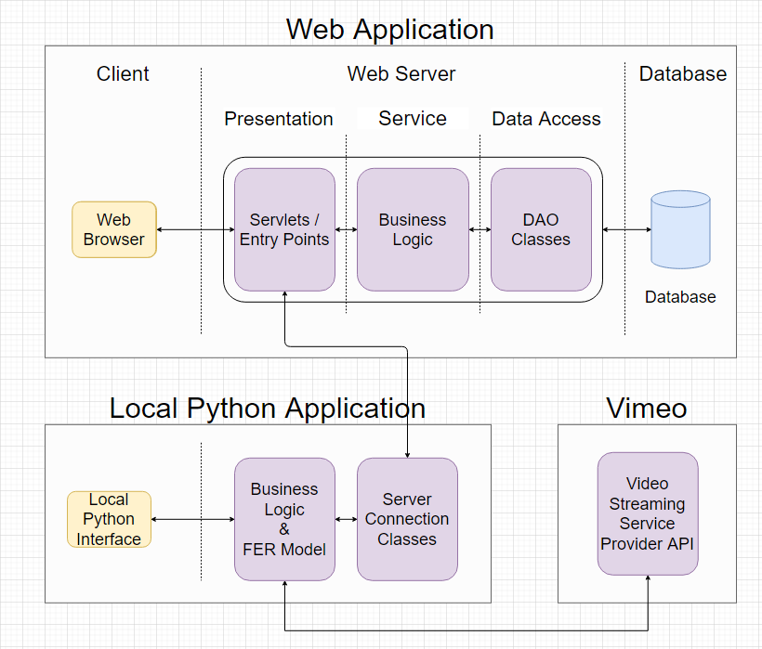
SYSTEM ARCHITECTURE
7
Pixelast | Design and Tech

Slide 8
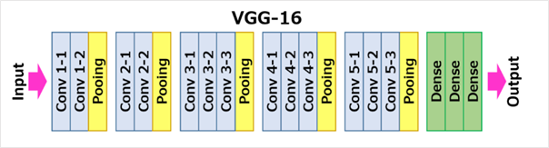
FER MODEL ARCHITECUTRE
The model chosen is the VGG-16 model
It is an award winning Convolutional Neural Network (CNN) in 2014
It consists of 5 blocks
Each block starts with convolutional layers followed by a pooling layer
8

Slide 9
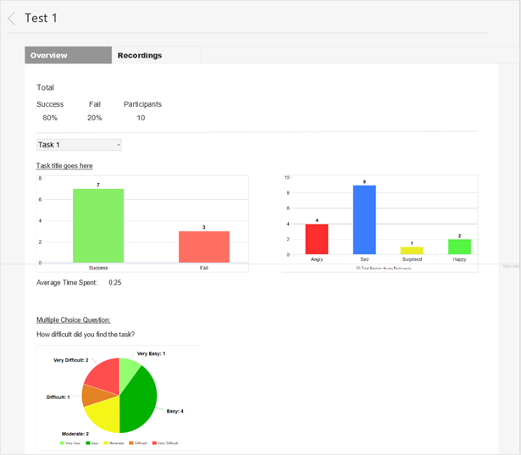
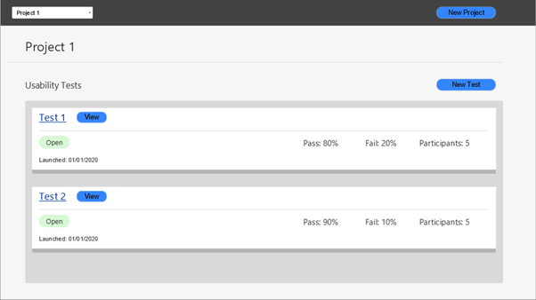
FRONT-END
WEB APPLICATION
PROTOTYPES
9

Slide 10
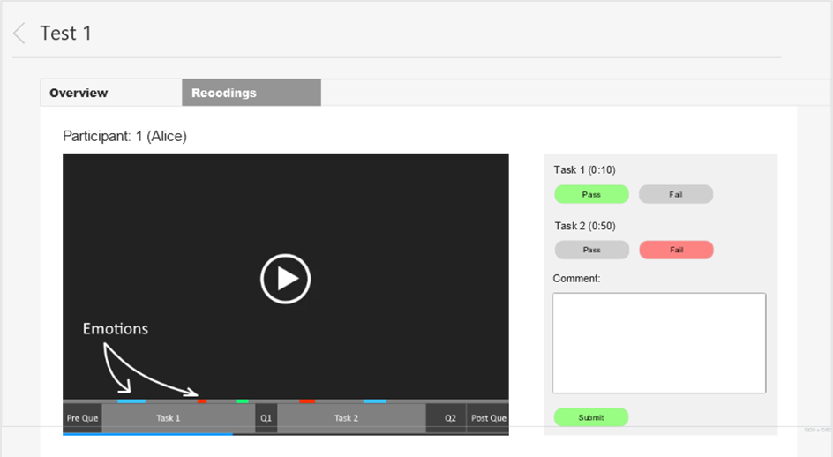
FRONT-END
WEB APPLICATION
PROTOTYPE
10

Slide 11
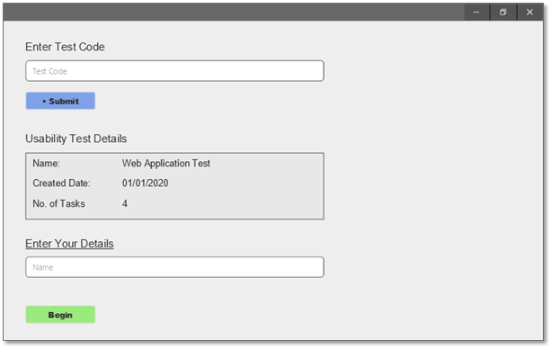
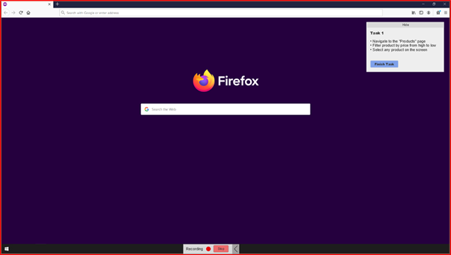
LOCAL PYTHON APPLICATION PROTOTYPE
11

Slide 12
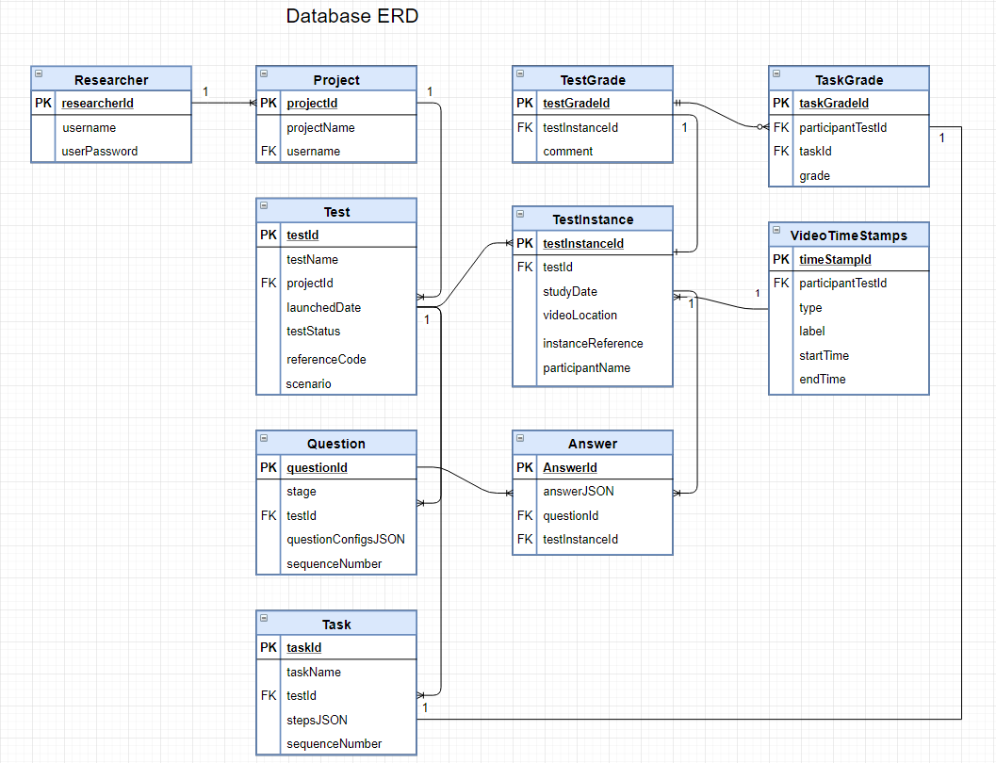
DATABASE
ENTITY RELATIONSHIP
DIAGRAM
(PRODUCTION)
12
12

Slide 13
Operating Systems
Windows 10
Programming Languages
Java
JavaScript
Python
Databases
MySQL
Frameworks & Libraries
Spring
React
JDBC
TensorFlow
Keras API
PyQt5
Tools
GitHub
Anaconda & Jupyter
VS Code
Eclipse IDE
MySQL Workbench
Other
Vimeo
Heroku
DEVELOPMENT
TECHNOLOGIES
CHOSEN
13
Pixelast | Design and Tech

Slide 14
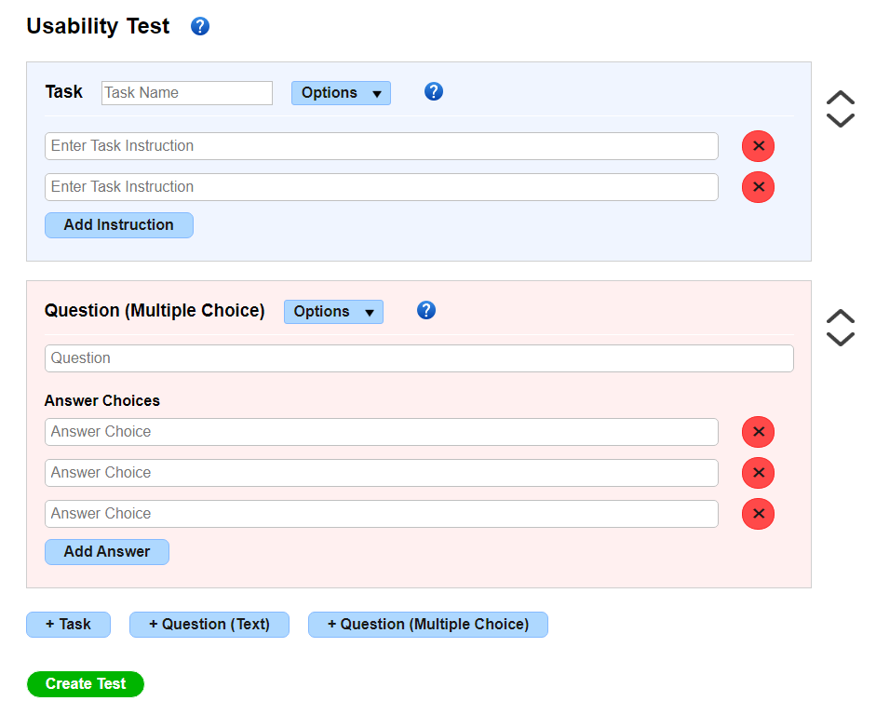
DEVELOPMENT
REACT
Being New
Render/Re-rendering
Dynamic Components
Charting Library
14

Slide 15
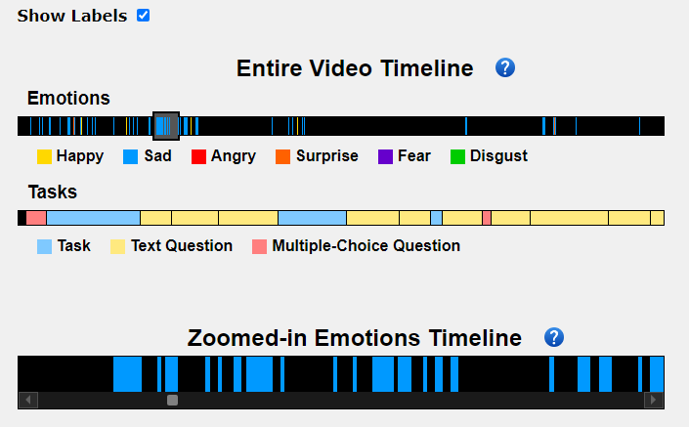
DEVELOPMENT
VIDEO TIMELINES
Broken Libraries
Vimeo API (Interactive)
Great End Result
Video Embedding (Cross-site policies)
15

Slide 16
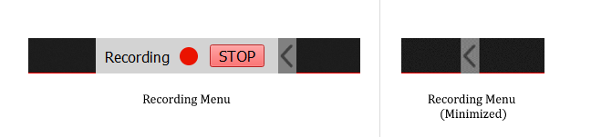
DEVELOPMENT
SCREEN RECORDER
Frame & Time Sync
16

Slide 17
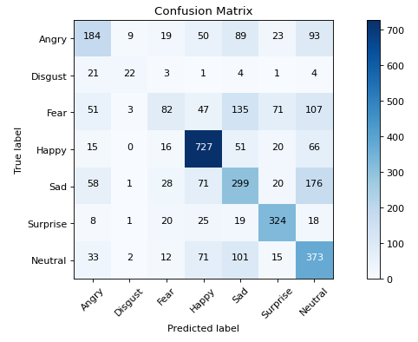
DEVELOPMENT
MACHINE LEARNING
Anaconda
Installing Libraries
Configuring GPU
Displaying Confusion Matrix
Data Loader
17

Slide 18
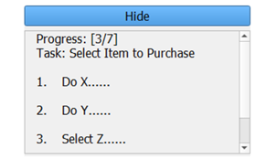
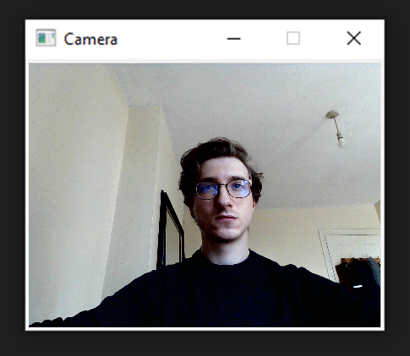
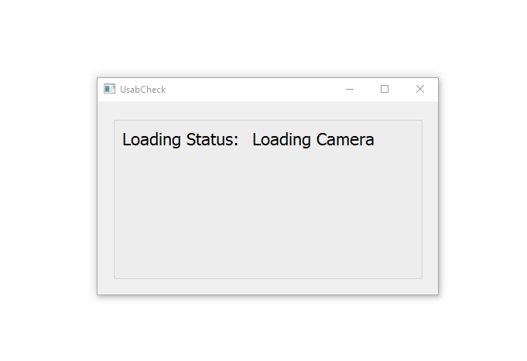
DEVELOPMENT
LOCAL APPLICATION
New to UI Dev in Python & PyQt5
Concurrency/Multi-threading
Component Loading
Integrating FER Model
18

Slide 19


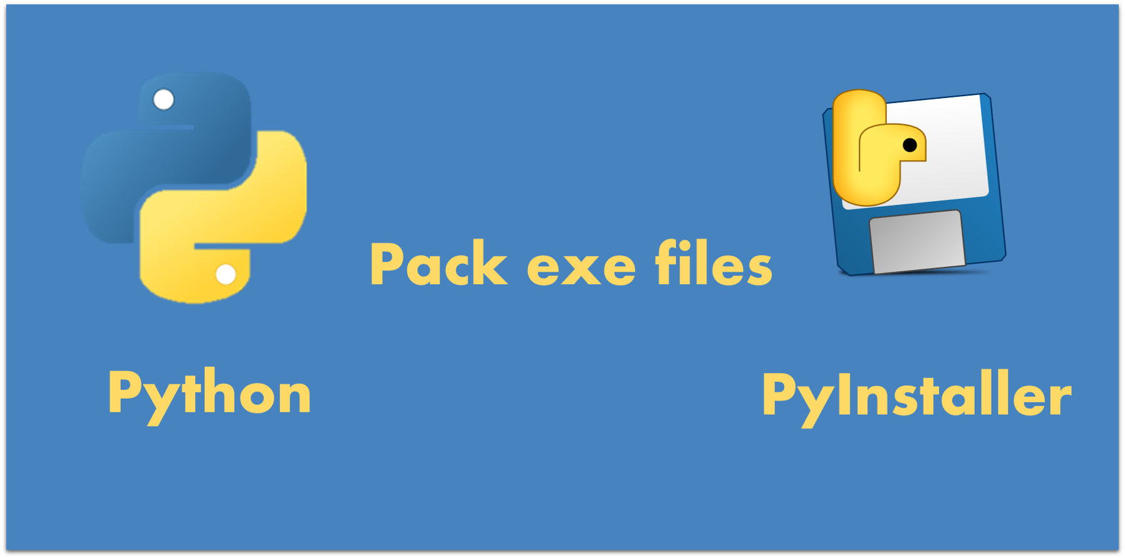
DEVELOPMENT
DEPLOYMENT
Automated Deployment Plugins
Heroku Build Packs
18

Slide 20
DEMO
THE WEB APPLICATION & LOCAL APPLICATION WILL BE PRESENTED
VIDEO LINK:
https://youtu.be/cFu9bzQoGSs
19

Slide 21
Facial Expression Recognition Model
State-of-the-art accuracy of VGG model achieved on FER2013 dataset is 72.7%
The better model in this project which is a variation of the VGG-16 Model achieved an accuracy of 61% on test set
Model was tested on 2 other datasets and results were compared
Test occlusion of face and specific facial features and camera angles.
Testing model with participants and recording data
TESTING & EVALUATION
20
Pixelast | Design and Tech

Slide 22
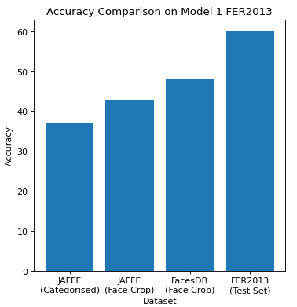
TESTING & EVALUATION
22
Pixelast | Design and Tech

Slide 23
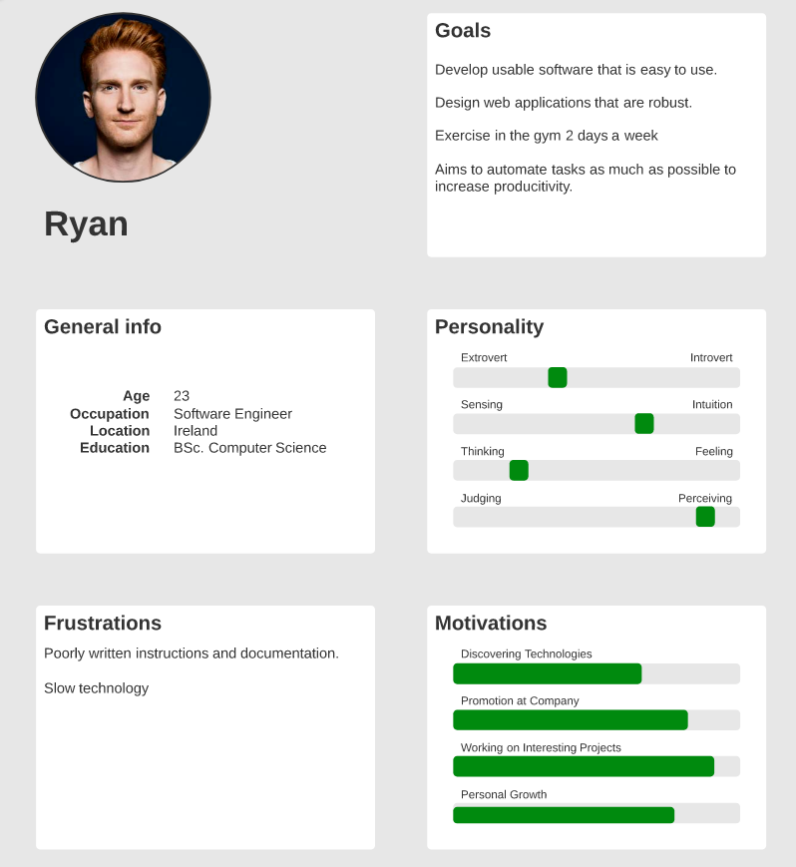
TESTING & EVALUATION
24
Pixelast | Design and Tech

Slide 24
Web App & Local Application
Black-box system testing was conducted via GUI to ensure the integrated components and the system was working.
While developing white-box and grey-box testing were conducted to ensure that the code was robust and working.
When applicable modules were tested on their own before being integrated into the system.
Automated unit testing was performed on the local application
Both applications were evaluated by an expert and Nielsen’s heuristics
Separate usability studies were conducted to test both applications.
Impaired vision simulator was used on web app
TESTING &
EVALUATION
21
Pixelast | Design and Tech

Slide 25
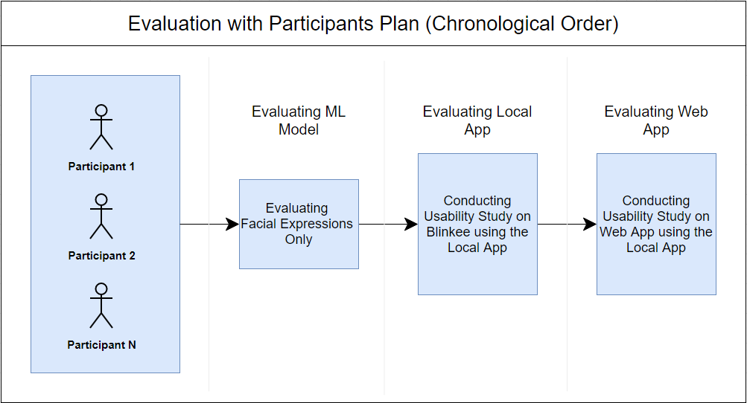
Web App & Local Application
Principles of Universal Design and Gestalt principles were considered throughout the development
TESTING &
EVALUATION
22
Pixelast | Design and Tech

Slide 26
CONCLUSIONS
A way to display emotions on a timeline has been developed and made interactive
Both negative and positive emotions can be a sign of usability problems
Not all problems were expressed with facial expressions
Glasses had a significant negative effect on FER accuracy
23

Slide 27
Other models/techniques
Resnet
Image Processing
Other datasets
Usability study specific
Include individuals with glasses in dataset
UI and usability improvements
Remove scrolling
FUTURE WORK
24

Slide 28
Thank you for listening!
Please feel free to ask any questions

